Slide 1
Year 6 Staff
Poplar Class: Mr Sagar
Pine Class: Mr Southall
Teaching Assistants – Mrs Rees
Thursday PPA cover- Mr Tinsley and Miss McBride

Slide 2



Slide 3
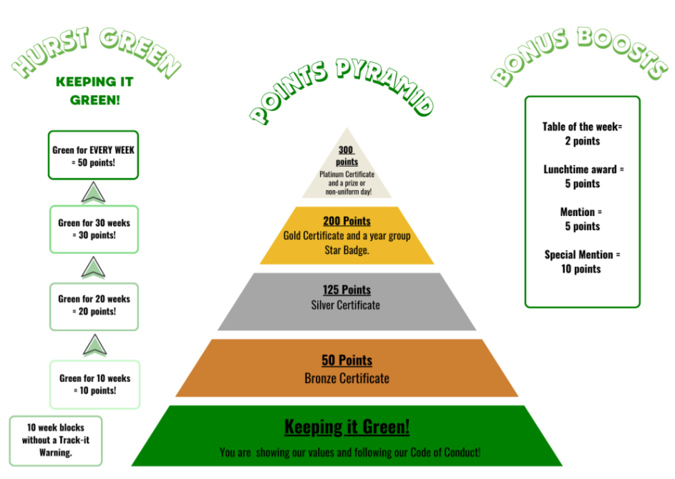

Slide 4
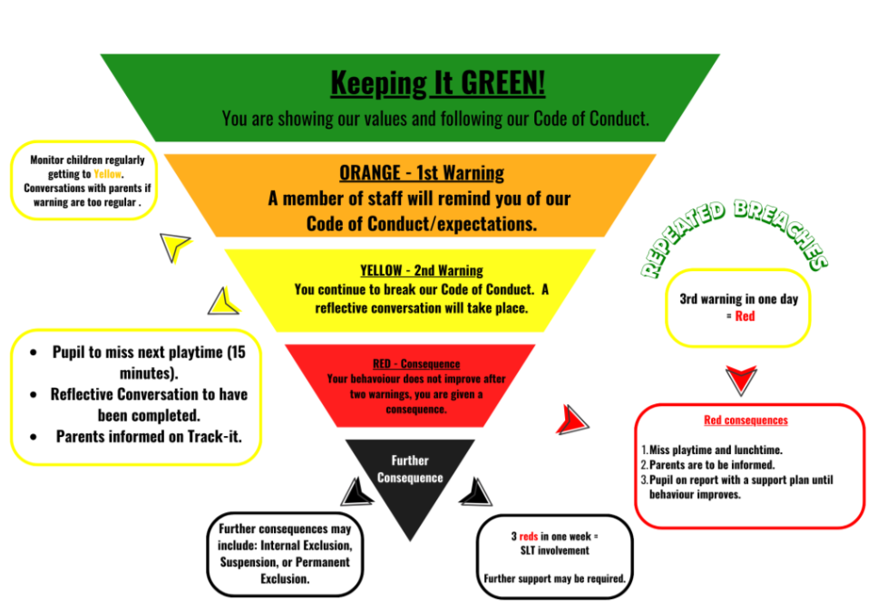

Slide 5
Building an Attendance Culture
Our new approach to attendance is rooted in an inclusive attendance model designed to ensure that everyone - our staff, families, and children - fully understands their individual roles and collective responsibilities in supporting school attendance, active engagement in learning, and addressing potential barriers
We will be reporting attendance in terms of days missed, rather than a percentage, to make communications easier to understand.

Slide 6
Read regularly (at least 3 times a week)
Multiplication practise
SATs
Home Learning

Slide 7
Home learning - apps
Children have access to the following apps:
TTRS (times table practise – children need instant recall of these for all aspects of Maths).
SPAG.com (online SPAG test practise – this will be utilised more after January, with teachers setting regular practise tests).
Maths.co.uk (similar to SPAG – again to be utilised in the run up to SATs).

Slide 8
Classroom Admin
PE days will be on Tuesday and Thursdays– children should come to school in their PE kit on these days.
Reading records need to be in school each day – children will use these regularly for: referencing key facts, looking up their usernames/passwords.
Reading books and records should be taken home each night and brought into school each morning.
Water bottle
Snack

Slide 9

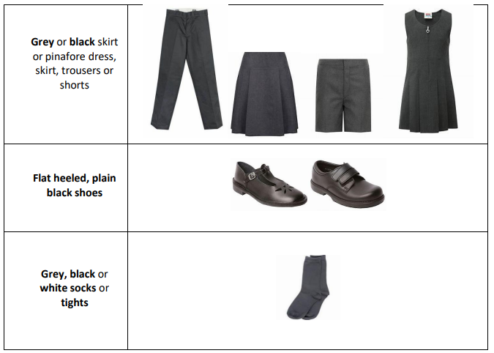
Uniform

Slide 10
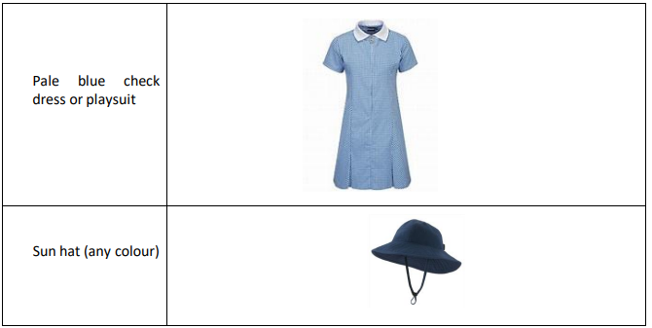
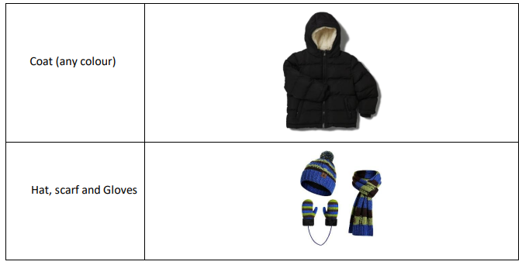
Uniform

Slide 11
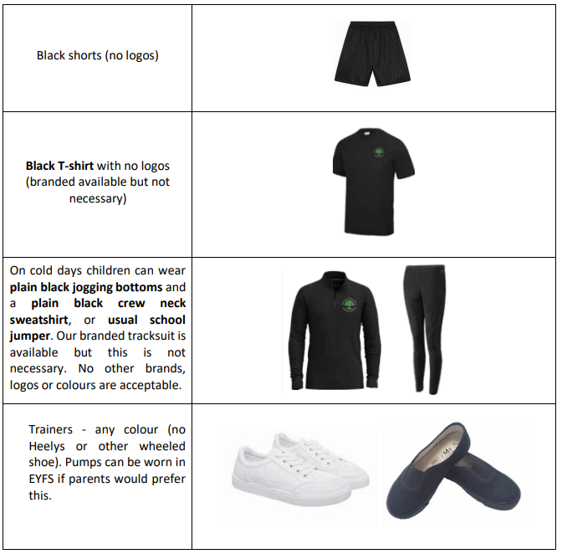
Uniform

Slide 12
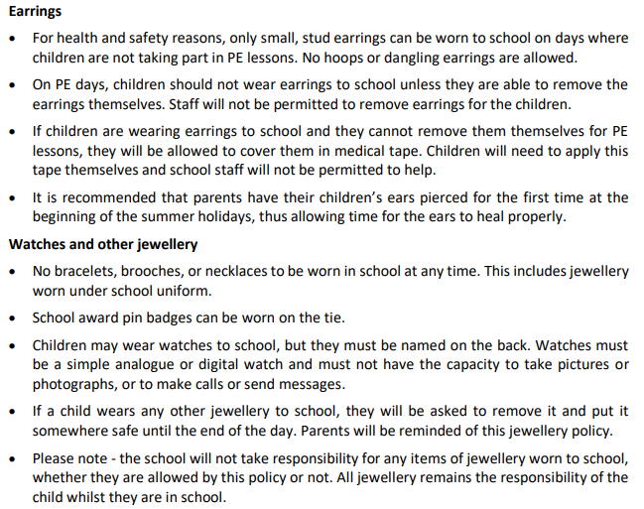
Jewellery

Slide 13
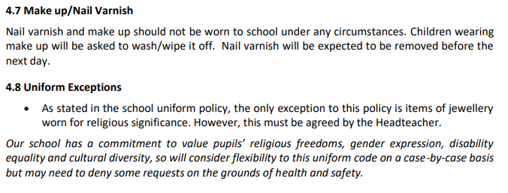
Jewellery

Slide 14
SATs
SATs are the Standardised Assessment Tests that are given to children at the end of Key Stage 2.
The SATs take place over four days, starting on Monday 11th May ending on Thursday 14th May.
The SATs papers consist of:
  Grammar, punctuation and spelling (paper 1: GPS)
  Grammar, punctuation and spelling (paper 2: Spelling
  Reading
  Maths (paper 1: Arithmetic
  Maths (paper 2: Reasoning
  Maths (paper 3: Reasoning)
  Writing is assessed using evidence collected throughout Year 6. There is no Year 6 SATs writing test.
The key stage 2 tests will be taken on set dates unless your child is absent, in which case they may be able to take them up to 5 school days afterwards.

Slide 15
Residential
Nearer the time, there will be a meeting to discuss residential

Slide 16

Any Questions?

